Slide 1

Mining Concept-Drifting Data Streams using Ensemble Classifiers
Stream Mining Assignment 3
Weighted Ensemble Classifier

Slide 2
TRADITIONAL DATA MINING
Traditional data mining algorithms is used to Mining models from large databases with bounded memory.
These algorithms require multiple scans of the training data which makes them inappropriate in the streaming data environment.
Examples can not be repeatedly analyzed in the case of Stream Data.

Slide 3
Mining Stream Data
Mining Stream Data is non-trivial due to the following challenges:
1. Concept drifts.
2. High data rate.
3. Low memory footprints.
4.Low processing time.
5. Algorithms needs to be robust and easy to use.

Slide 4
Basic Idea about Algorithm
In this assignment the idea propesed is a general framework for mining concept-drifting data streams using weighted ensemble classifier.
What is Ensemble Classifiers approach?
An ensemble of classifiers/ Ensemble Classifiers is a set of classifiers whose individual decisions are combined in some way (typically by weighted or unweighted voting) to classify new examples.

Slide 5
Why Weighted Ensemble Classifier?
ACCURACY:
The model learned from the streaming data must be able to capture up-to-date trends and transient patterns in the stream.
We must also eliminate the effects of examples representing outdated concepts.
The classifiers in the ensemble are weighted based on their expected classification accuracy on the test data under the time-evolving environment.
Thus, the ensemble approach improves both the efficiency in learning the model and the accuracy in performing classification.

Slide 6
EASE OF USE:
Instead of continuously revising a single model, training an ensemble of classifiers from sequential data chunks in the stream.
In order to avoid overfitting and the problems of conflicting concepts, the expiration of old data must rely on data’s distribution instead of only their arrival time.
The ensemble approach gives each classifier a weight based on its expected prediction accuracy on the current test examples.

Slide 7
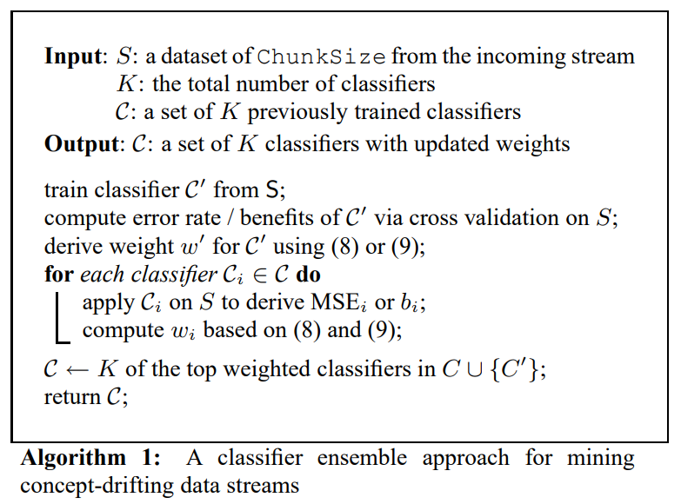
Ensemble Approach :

Slide 8
Accuracy-Weighted Ensembles:Working and Usage
The weight of classifier is derived by estimating its expected prediction error on the test examples.
The mean square error of classifier can be expressed by: MSEi
The weight of classifier should be reversely proportional to MSEi. So higher the error less is the weight.
On the other hand, a classifier predicts randomly, will have mean square error: MSEr (r:randomly)
MSEr, is used as a threshold in weighting the classifiers. That is, we discard classifiers whose error is equal to or larger than MSEr.
So the weight wi for classifier Ci is given by this formula: wi = MSEr − MSEi
Return the classifier of Top weighted classifiers

Slide 9
Usage:
For classifying future or unknown objects.
For Estimation the Accuracy of the Model
If accuracy is acceptable use the model to classify data records whose class labels are not known.

Slide 10
Results
I have implemented the Algorithm 1 of the paper which is Weighted Ensemble Classifier.
The implementation follows the techniques described in
"Mining Concept-Drifting Data Streams using Ensemble Classifiers", by
Haixun Wang, Wei Fan, Philip S. Yu, Jiawei Han
In the last part of the notebook a stream is prepared and accuracy of this Ensemble Classifier is obtained.
Accuracy obtained: 78 Percent

Slide 11
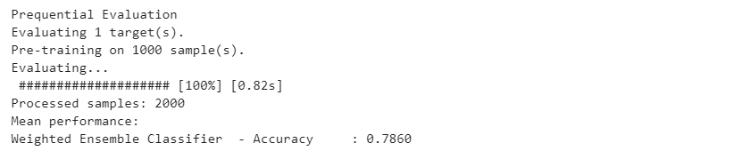
Accuracy Obtained for Weighted Ensemble Classifier:

Slide 12
Thank you
Deepika Mahajan
T1VISF

